Slide 1
Road Maker
By : Group 6( Don Jose,
Dominic K Savio,
Alen Varghese,
Shanu P Shaji)
Guide : Saumya Sadanandan
Amal Jyothi College Of Engineering

Slide 2
Problem Statement
Potholes are not being fixed in a feasible time frame
We plan to find and prioritize which pothole needs to be fixed
Nobody knows what is the updated state of the place

Slide 3
Objectives
a)CrowdSource the data
b)Analyse the data
c)prioritize it to hotspots
d)update the data by crowd sourcing

Slide 4
Front end
User Registration → admin
Admin Panel (crowd sourced)
View where are the hotspots
Update news on the place

Slide 5
Inside the web framework
Implemented in the Django server
Tagging photos done in go
Mass photo repetition avoided
Clustering on cron job(now pinging the server)

Slide 6
Database
Implemented the database schema
Tested using the postgres database server
CRUD operation done

Slide 7
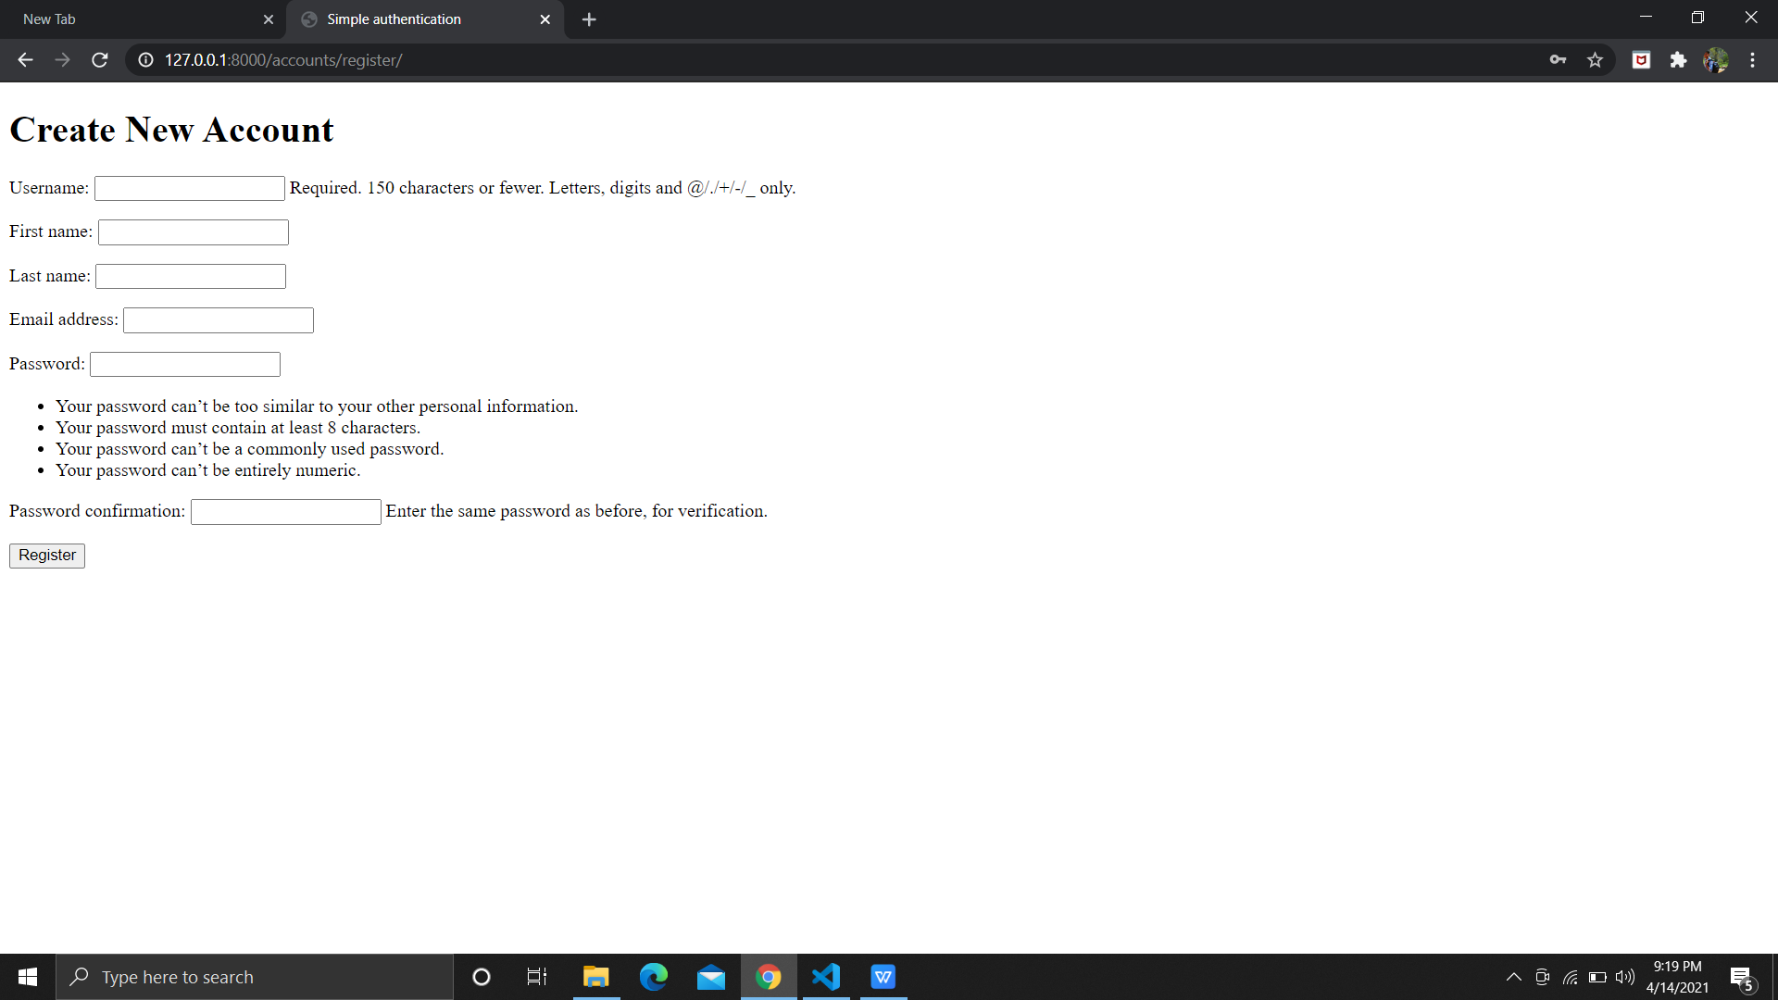
User Registration

Slide 8
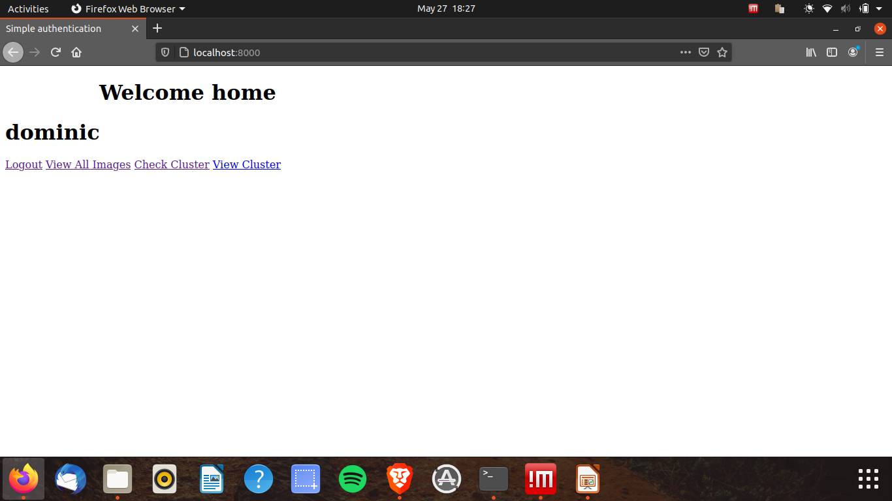
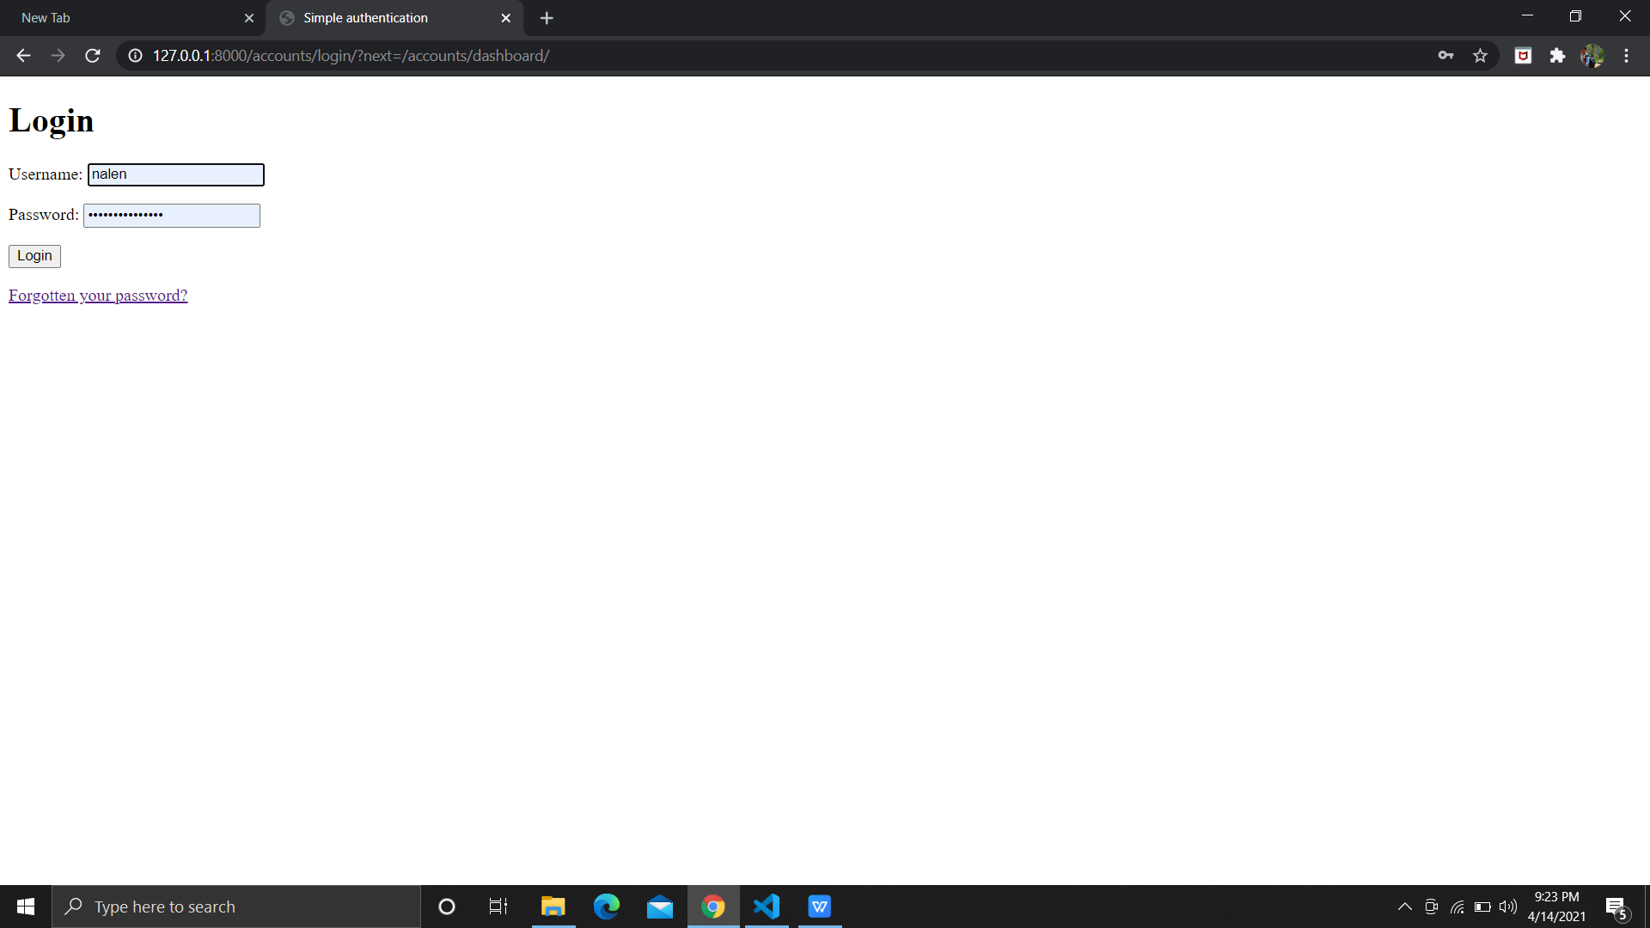
Login and Logout

Slide 9
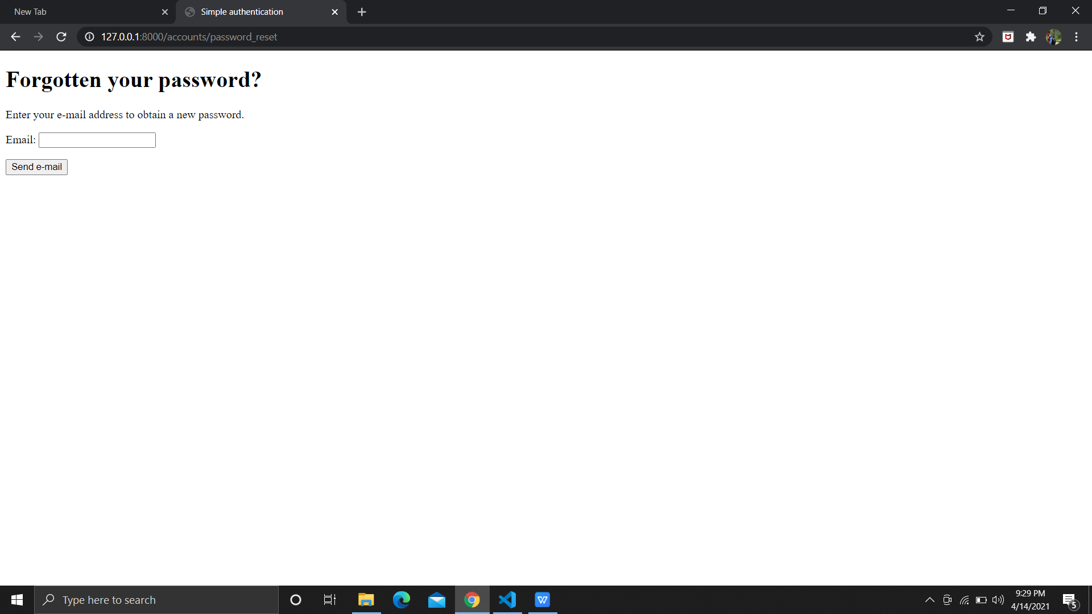
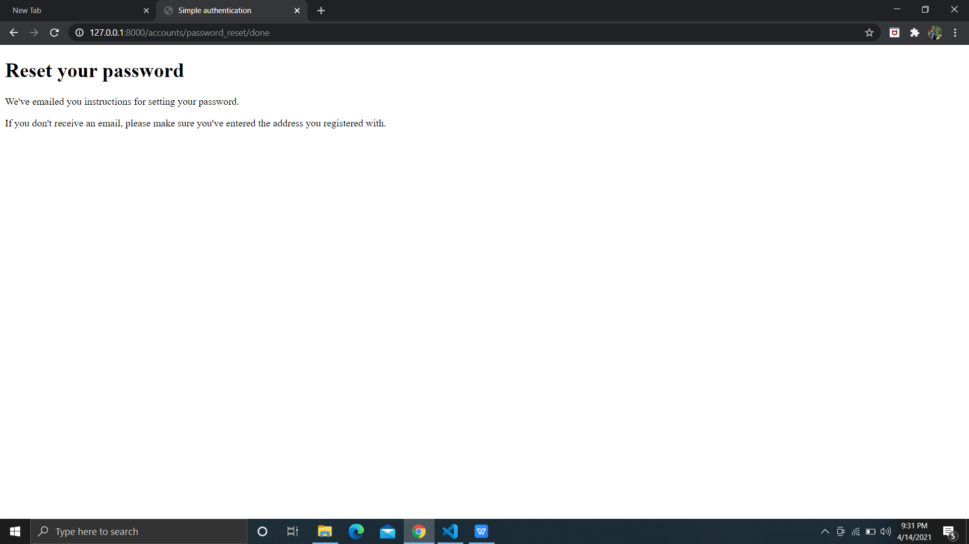
Forgot Password

Slide 10
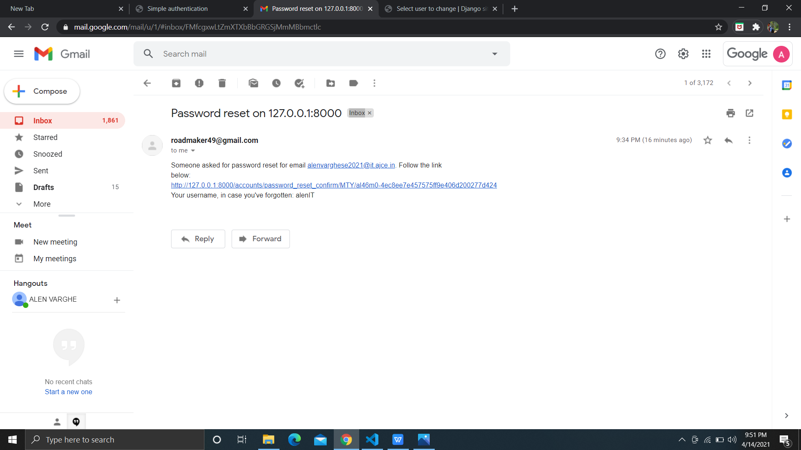

Slide 11
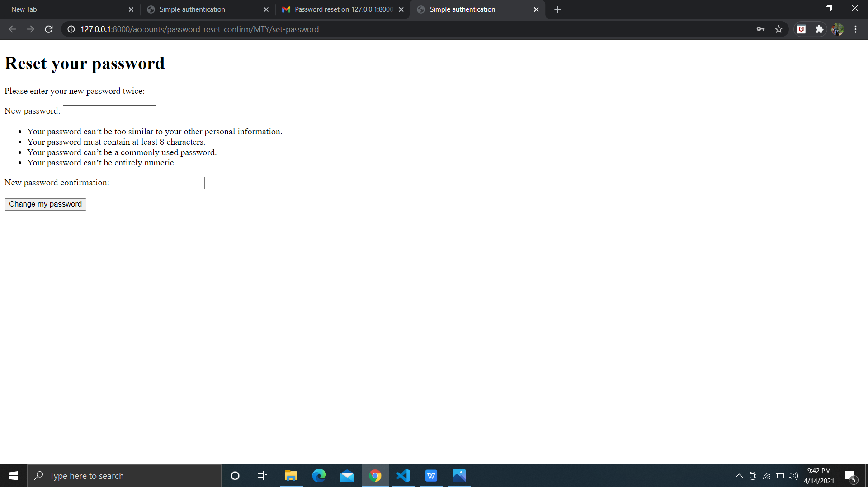

Slide 12
Data Analysis
Checked various algorithms
Selected DBSCAN
Clustering done using sample data sets created by developers
Selected for its adaptability and found satisfactory
Analyzed the data
Running every day or so with a cron job

Slide 13
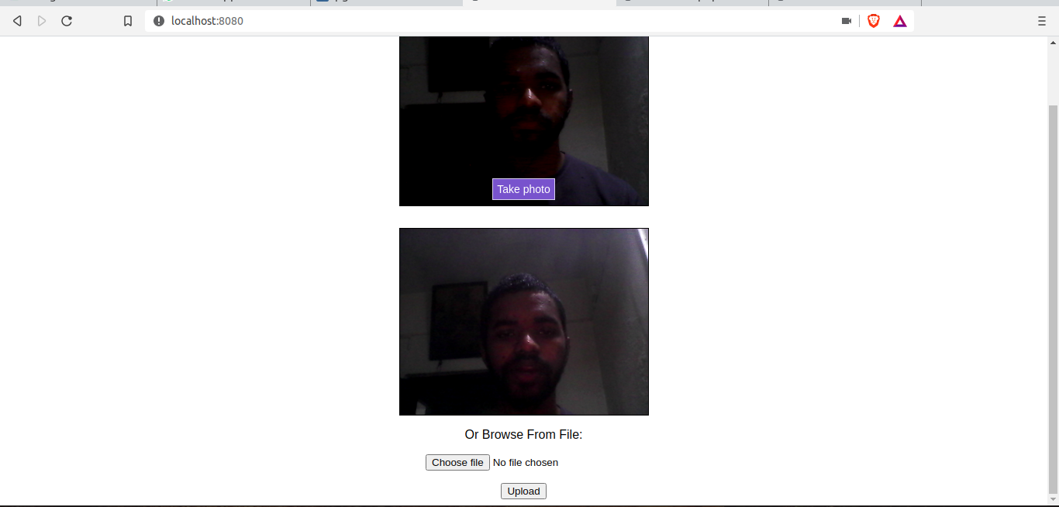
Anyone can tag

Slide 14
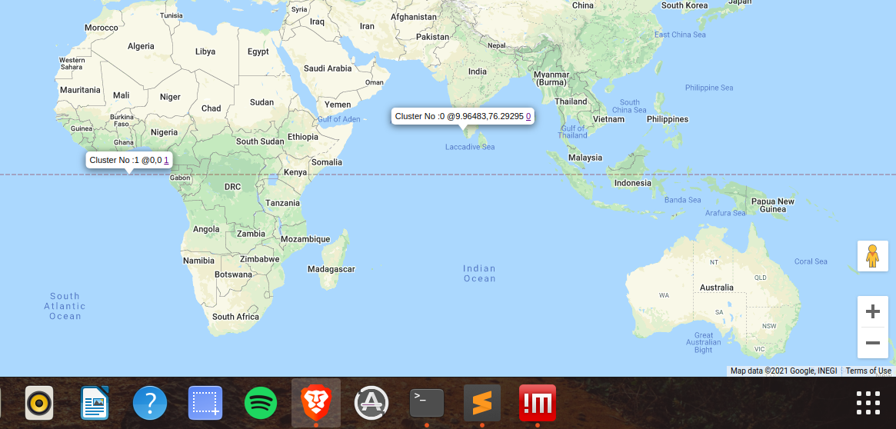
Everyone can view

Slide 15
Everyone can view

Slide 16
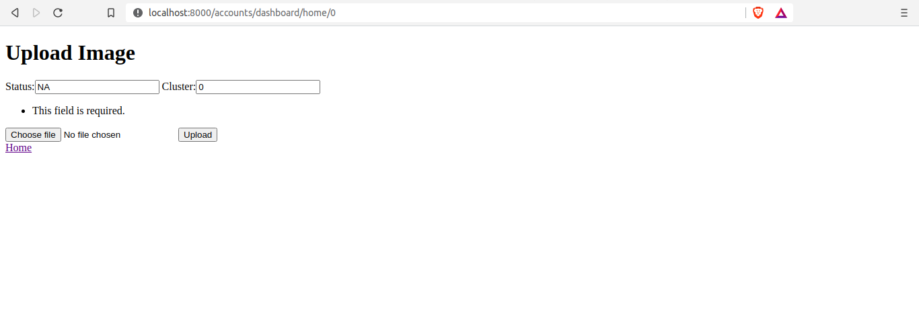
Everyone can update

Slide 17
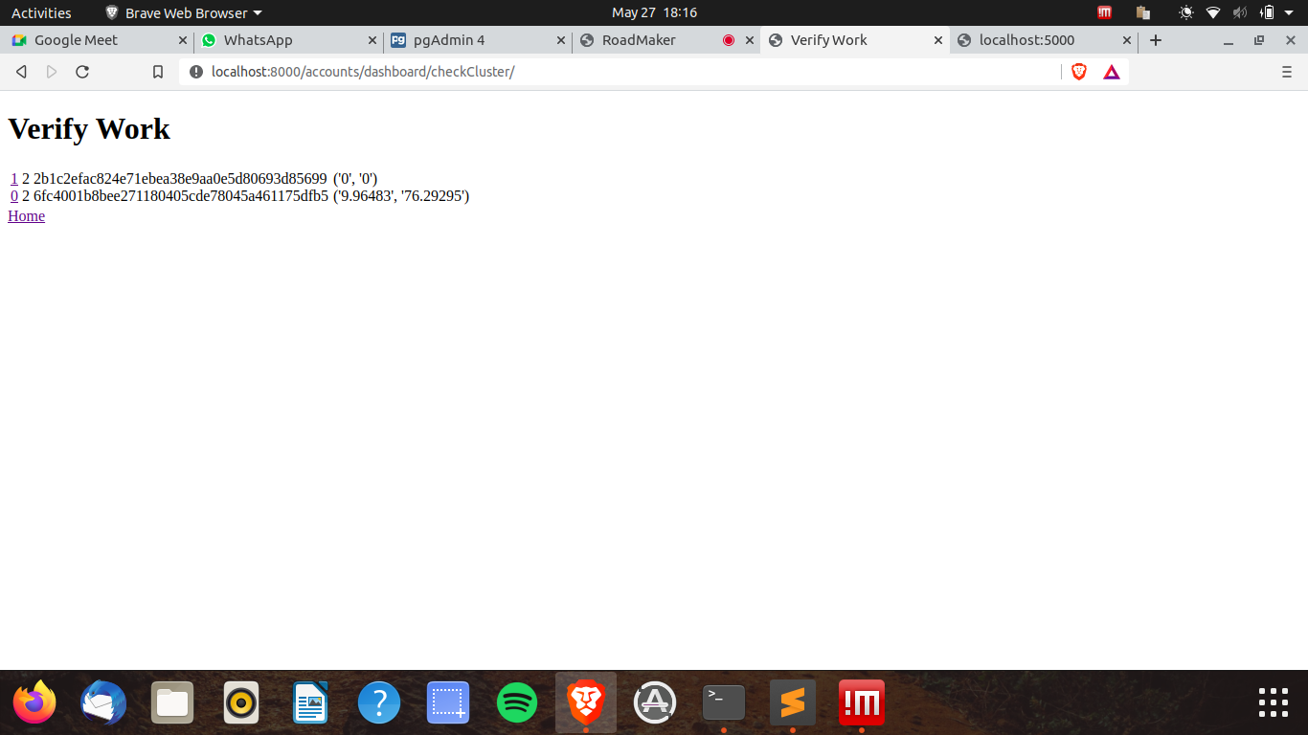
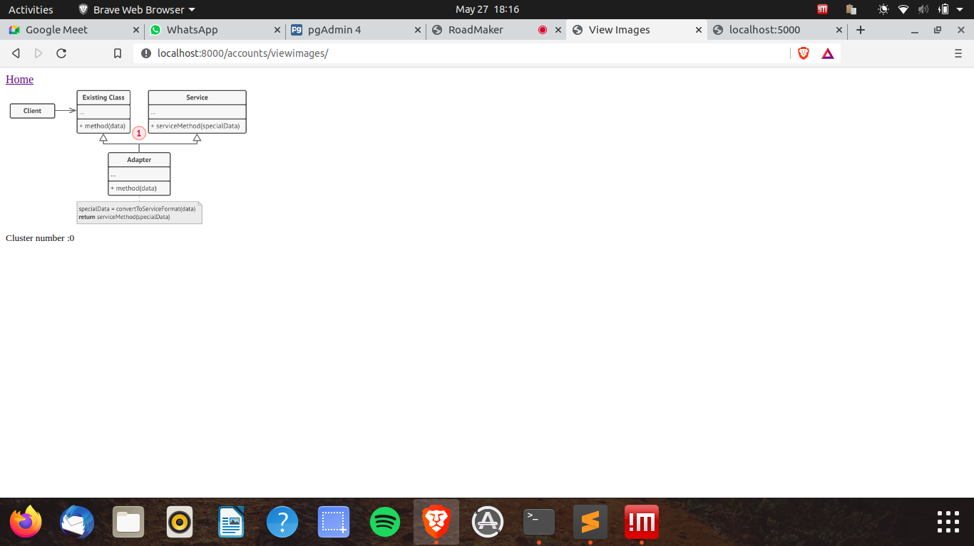
Everyone can update

Slide 18
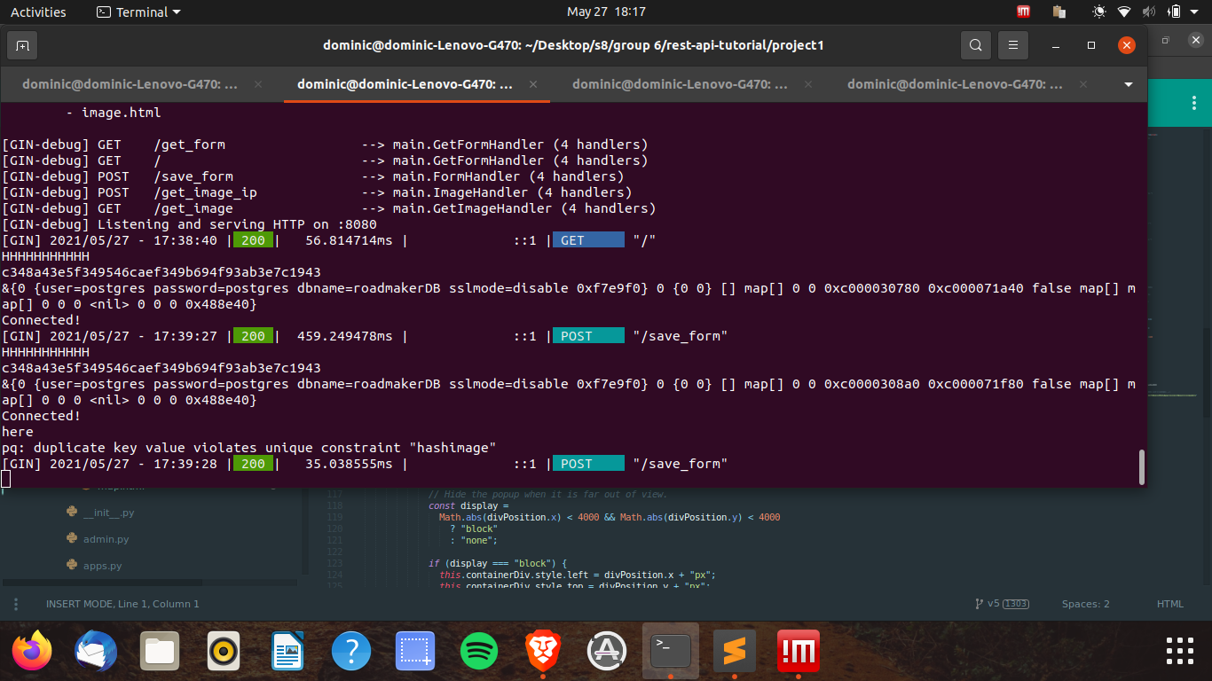
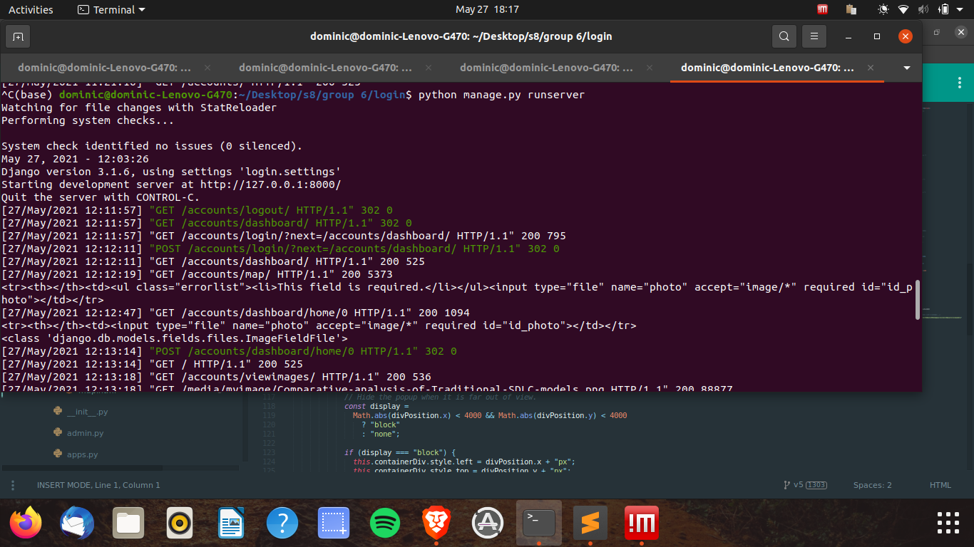
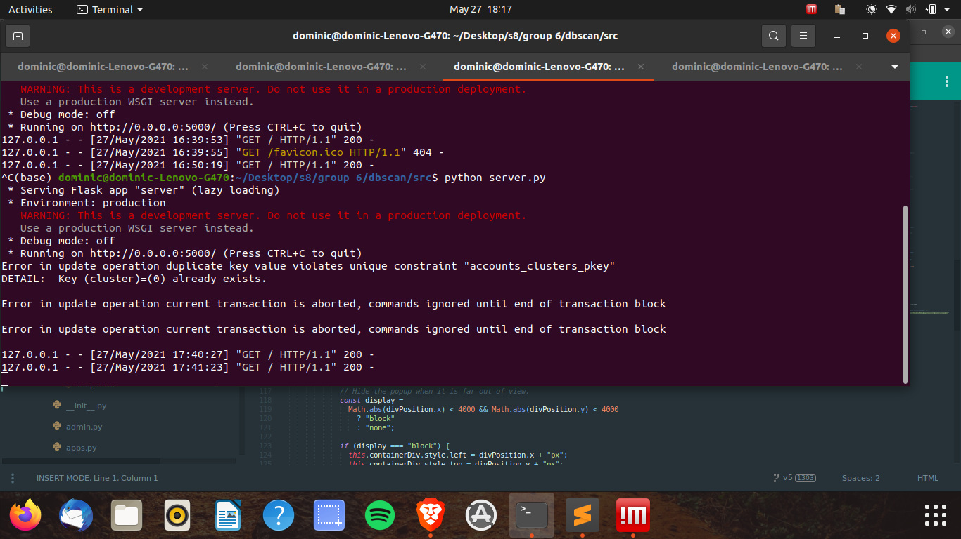
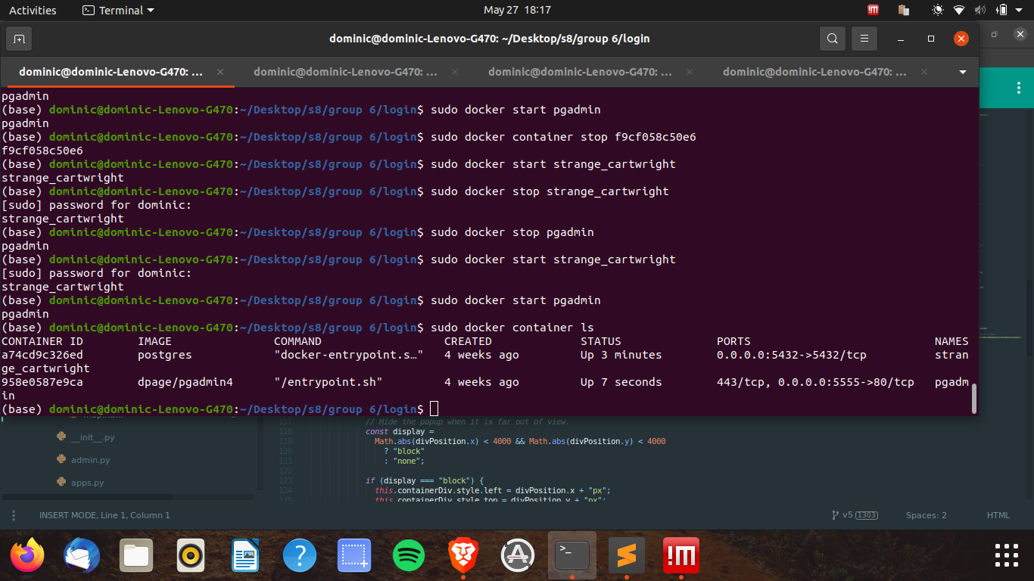
To be deployed

Slide 19
Thank you

